Slide 1

Islamic Schools Association
Conference
Arkana College, Sydney
Bill Daniels
Executive Director, ISCA
14 September 2012

Slide 2
Australian school enrolments 2011
 | Students |  |  | Enrolment Share
 | Primary | Secondary | Total | Primary | Secondary | Total
Independent* | 237,466 | 263,092 | 500,558 | 11.7% | 17.7% | 14.2%
Catholic | 396,259 | 327,757 | 724,016 | 19.5% | 22.1% | 20.6%
Government | 1,403,429 | 891,556 | 2,294,985 | 68.9% | 60.1% | 65.2%
TOTAL | 2,037,154 | 1,482,405 | 3,519,559 | 100.0% | 100.0% | 100.0%
Source: ABS Schools Australia 2011 (FT enrolments)
* When including independent Catholic schools enrolments are close to 553,000.

Slide 3
Enrolment share by sector 1970 to 2011
Source: ABS Schools Australia FT data

Slide 4
Enrolment change by sector 1985 - 2011
Source: ABS Schools Australia FT data

Slide 5
Enrolment growth by sector 1995 - 2011
Source: ABS Schools Australia FT data

Slide 6
Size of Jurisdiction/Sector by Enrolments 2011*
Jurisdiction/Sector | Enrolments
NSW Govt | 745,540
Catholics | 672,975
Independent | 552,763
VIC Govt | 541,212
QLD Govt | 491,780
WA Govt | 237,118
SA Govt | 165,899
TAS Govt | 58,451
ACT Govt | 34,643
NT Govt | 29,165
Source: ABS Schools Australia 2011 and DEEWR Non-government Schools Census data
*Independent Catholic enrolments have been allocated to the independent sector

Slide 7
Change in number of independent schools over previous year 1996 - 2011
Source: ABS Schools Australia

Slide 8
Average size of independent schools 1980 - 2011
 | No. schools | FT enrolments | Average school size
1980 | 529 | 144,270 | 273
1990 | 803 | 252,611 | 315
2000 | 938 | 357,507 | 381
2011 | 1,020 | 500,558 | 491
Source: ABS Schools Australia FT enrolment data and school data

Slide 9
Projected enrolment change in all schools 2011 - 2020
 | 2011 | 2020 | Change (no.) | Equivalent number of new schools*
Government Schools
Primary | 1,403,429 | 1,747,547 | 344,118 | 1,005
Secondary | 891,556 | 910,518 | 18,962 | 55
Total | 2,294,985 | 2,658,066 | 363,081 | 1,061
Catholic Schools
Primary | 396,259 | 496,585 | 100,326 | 237
Secondary | 327,757 | 375,200 | 47,443 | 112
Total | 724,016 | 871,786 | 147,770 | 349
Independent Schools
Primary | 237,466 | 313,630 | 76,164 | 155
Secondary | 263,092 | 344,285 | 81,193 | 165
Total | 500,558 | 657,914 | 157,356 | 321
All Schools
Primary | 2,037,154 | 2,557,762 | 520,608 | 1,398
Secondary | 1,482,405 | 1,630,003 | 147,598 | 333
Total | 3,519,559 | 4,187,766 | 668,207 | 1,730
Source: DEEWR Projections and ABS Schools Australia
*Based on average school size by sector for 2011 derived from ABS data.

Slide 10
Sector diversity
Indigenous students | 9,518
Independent schools with 50%+ indigenous enrolment | 36
Students with disabilities | 13,148
Special schools | 65
Overseas students | 7,331
Boarding students | 16,511
Boarding schools | 149
Schools with less than 200 students | 38%
Schools with 200 – 999 students | 44%
Schools with 1,000 – 2,000 students | 16%
Combined schools (primary & secondary) | 64%
Note: Figures include independent Catholic schools and enrolments

Slide 11
Independent school affiliations 2011
Affiliation | Schools | Student FTE | %
Anglican | 151 | 139,915 | 25.3%
Non-Denominational | 187 | 72,325 | 13.1%
Christian Schools | 134 | 55,731 | 10.1%
Uniting Church in Australia | 44 | 50,344 | 9.1%
Catholic | 59 | 47,903 | 8.7%
Lutheran | 86 | 37,410 | 6.8%
Islamic | 33 | 21,576 | 3.9%
Baptist | 43 | 18,647 | 3.4%
Inter-Denominational | 27 | 16,592 | 3.0%
Seventh Day Adventist | 48 | 11,147 | 2.0%
Presbyterian | 14 | 9,961 | 1.8%
Jewish | 19 | 8,899 | 1.6%
Steiner School | 43 | 7,687 | 1.4%
Pentecostal | 17 | 7,465 | 1.4%
Assemblies of God | 11 | 5,635 | 1.0%
Brethren | 8 | 4,514 | 0.8%
Greek Orthodox | 8 | 3,760 | 0.7%
Montessori School | 39 | 4,098 | 0.7%
Other Catholic | 7 | 3,441 | 0.6%
Other Orthodox | 6 | 2,092 | 0.4%
Other Religious Affiliation* | 12 | 5,238 | 0.9%
Other** | 90 | 18,381 | 3.3%
*Other Religious includes Churches of Christ, Ananda Marga, Hare Krishna and Society of Friends
**Other includes special schools, international schools, indigenous schools, and community schools.

Slide 12
Increase in students with disabilities in independent schools 1995 - 2011
Source: DEEWR Non-government school census data
Excludes independent Catholic enrolments

Slide 13
Increase in indigenous students in independent schools 1995 - 2011
Source: ABS Schools Australia
Excludes independent Catholic enrolments

Slide 14
FTE student and staff change 2001 - 2011
Sector | Students | Teachers | Non-Teaching
Independent | 34.7% | 42.8% | 76.5%
Catholic | 11.6% | 18.7% | 53.9%
Government | 1.9% | 8.4% | 37.2%
Source: ABS Schools Australia

Slide 15
Student/Teacher Ratios 1973 to 2011
Year | Government |  | Non-Government
 |  |  | Catholic |  | Independent
 | Primary | Secondary | Primary | Secondary | Primary | Secondary
1973 | 25.1 | 16.2 | 29.6 | 22.2 | 17.1 | 14.2
1980 | 20.2 | 12.2 | 23.9 | 16.6 | 17.3 | 13.3
1990 | 17.9 | 12.0 | 21.1 | 14.0 | 16.9 | 12.2
2000 | 17.1 | 12.6 | 19.1 | 13.4 | 15.7 | 11.4
2011 | 15.3 | 12.2 | 17.5 | 12.8 | 14.8 | 10.4
Source: ABS Schools Australia

Slide 16
The SES funding model
Final 2011 AGSRC
Primary $9,697; secondary $11,945
SES score 85
Primary $6,788; secondary $8,362
SES score 130
Primary $1,329; secondary $1,637

Slide 17
Sliding scale of funding entitlement per student according to SES score (2011 final amounts)

Slide 18
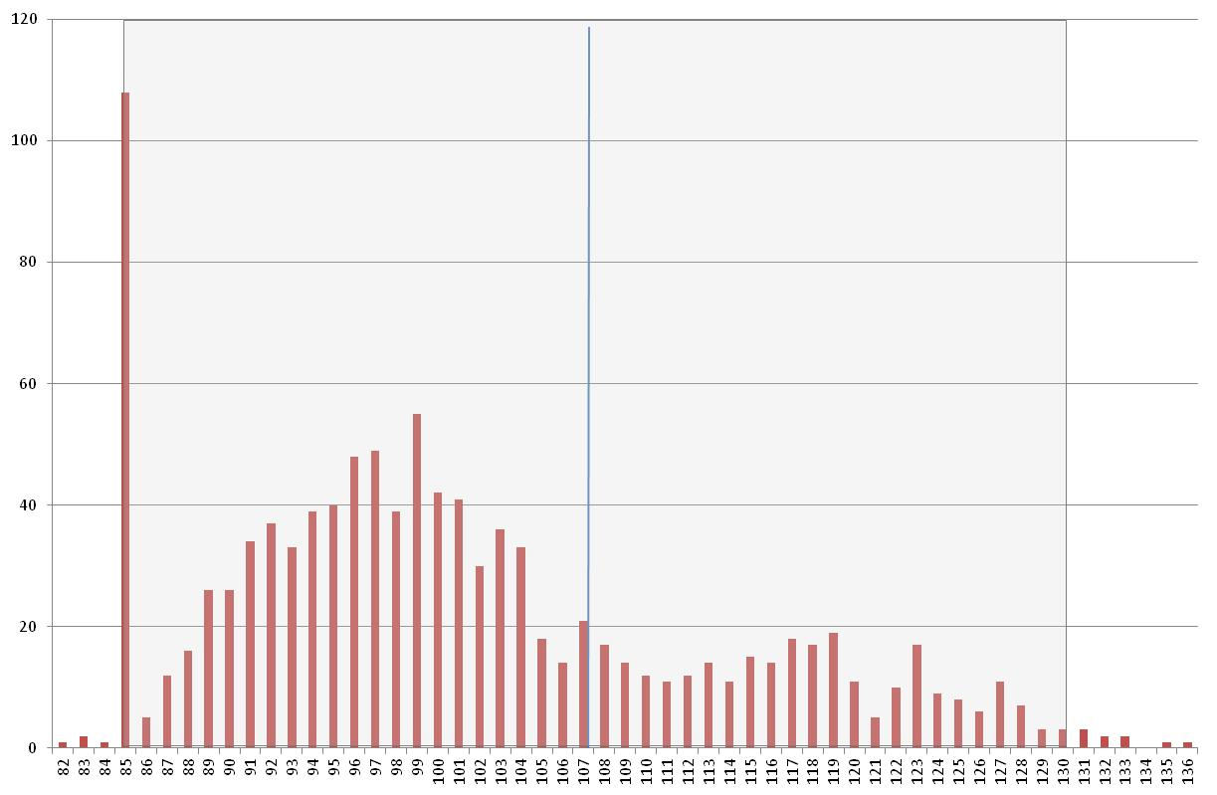
Independent schools by SES score 2011
75% of schools have an SES ≤107
Note: SES 85 includes Special schools, Special Assistance Schools (SAS) and Majority Indigenous Student Schools (MISS)

Slide 19
Distribution of non-government schools by SES score 2011
Source: DEEWR SES Funding table (as at 7th December 2011)
Note: =<85 includes Special schools, Special Assistance Schools (SAS) and Majority Indigenous Student Schools (MISS)

Slide 20
AGSRC Index supplementation 2000 to 2012
 | Primary AGSRC | Secondary AGSRC
2000 | 8.2% | 5.2%
2001 | 6.4% | 7.2%
2002 | 5.2% | 5.2%
2003 | 7.1% | 7.4%
2004 | 8.7% | 7.2%
2005 | 3.1% | 4.6%
2006 | 6.3% | 3.6%
2007 | 5.5% | 4.3%
2008 | 5.6% | 3.5%
2009 | 4.2% | 5.8%
2010 | 8.2% | 7.0%
2011 | 6.9% | 4.8%
2012 | 3.7% | 4.2%
Average | 6.1% | 5.4%

Slide 21
Funding Maintenance
182 independent schools (17%)
893 Catholic schools (54%)
On average, the value of FM for the independent sector is $676,565 per school (2010 data)

Slide 22
Number of Funding Maintained schools by sector and SES score 2011
Source: DEEWR SES Funding table (as at 7th December 2011)

Slide 23
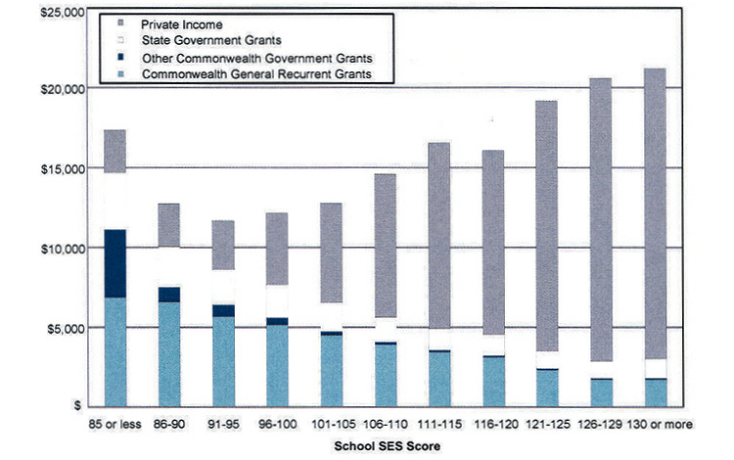
Non-systemic school funding sources by school SES score 2006
Annual funding per student
Source: ANAO analysis of non-government schools Financial Questionnaire data

Slide 24
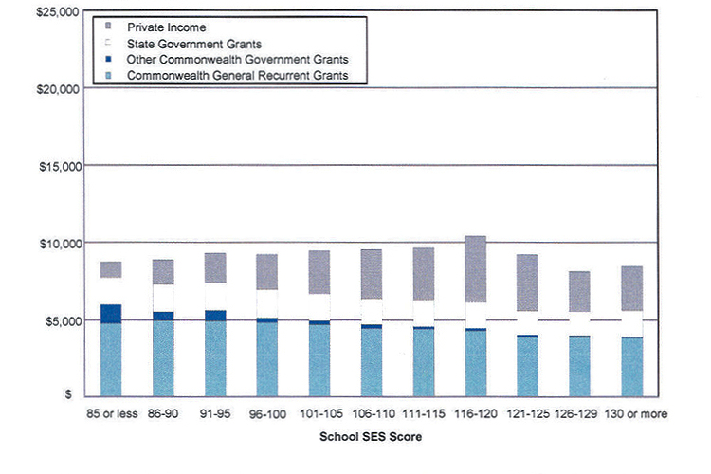
Systemic school funding sources by school SES score 2006
Annual funding per student
Source: ANAO analysis of non-government schools Financial Questionnaire data

Slide 25
Top and bottom 1,000 schools for net recurrent income per student - Australia
Highest net recurrent income per student
Catholic | 41
Government | 848
Independent | 111
 | 1,000
Sydney Grammar School | # 579
Lowest net recurrent income per student
Catholic | 404
Government | 570
Independent | 26
 | 1,000
Source: ACARA Financial Data – My School 3.0 (2010 Financial Data)
Note: Excludes schools with no NRIPS data.

Slide 26
Independent Schools with the highest NRIPS
(excluding schools with special circumstances)
School Name | State | Rank (counting down from highest NRIPS) | Net Recurrent Income per Student | FTE students 2011
Farmhouse Montessori School | NSW | 7 | $45,008 | 12
Barrenjoey Montessori School | NSW | 27 | $32,558 | 12
Sydney Grammar School | NSW | 44 | $29,670 | 1,119
The Kilmore International School | VIC | 89 | $26,958 | 406
St Joseph's College | NSW | 93 | $26,743 | 963
SCECGS Redlands | NSW | 95 | $26,675 | 1,309
Ascham School Ltd | NSW | 101 | $26,432 | 986
Inner Sydney Montessori School | NSW | 102 | $26,389 | 141
SCEGGS Darlinghurst | NSW | 110 | $25,775 | 898
Wesley College | VIC | 112 | $25,767 | 2,824
Melbourne Girls' Grammar School | VIC | 115 | $25,653 | 865
Melbourne Grammar School | VIC | 118 | $25,632 | 802
St Paul's International College | NSW | 121 | $25,544 | 187
Toogoolawa School | NSW | 122 | $25,542 | 14
The Melbourne City School | VIC | 124 | $25,505 | 31
St Catherine's School | VIC | 132 | $25,193 | 574
MLC School | NSW | 151 | $24,501 | 1,159
Barker College | NSW | 154 | $24,446 | 1,932
Aim Senior Secondary Music College | NSW | 157 | $24,310 | 43
Melbourne Montessori School | VIC | 158 | $24,293 | 42
Note: Excludes schools with data incomplete or blank, special schools, special assistance schools, Early Childhood Centres, remote and very remote schools, schools with less than 10 students, schools with 50%+ indigenous enrolments, distance education and youth in secure care.
Source: ACARA My School 3.0 (2010 Financial Data)

Slide 27
Net recurrent income per student – average school amount by sector by state
 | Net recurrent income per student
 | Government | Catholic | Independent
NSW | $11,216 | $10,459 | $15,523
VIC | $10,708 | $9,680 | $16,014
QLD | $11,029 | $10,508 | $12,514
SA | $12,238 | $11,128 | $12,777
WA | $13,562 | $11,121 | $13,450
NT | $17,874 | $14,441 | $15,461
TAS | $12,214 | $10,086 | $13,791
ACT | $13,128 | $9,967 | $13,986
Australia | $11,514 | $10,370 | $14,497
Source: ACARA My School 3.0 (2010 Financial Data)

Slide 28
Government Income per student – average school amount by state & sector
 | Government income per student
 | Government | Catholic | Independent
NSW | $10,687 | $8,493 | $6,973
VIC | $9,821 | $7,914 | $5,796
QLD | $10,371 | $8,186 | $6,978
SA | $11,508 | $8,218 | $6,893
WA | $13,055 | $8,851 | $7,313
NT | $17,319 | $12,259 | $11,258
TAS | $11,653 | $8,699 | $7,357
ACT | $12,479 | $7,091 | $6,333
Australia | $10,859 | $8,289 | $6,771
Source: ACARA My School 3.0 (2010 Financial Data)

Slide 29
Private Income per student – average school amount by state & sector
 | Private income per student
 | Government | Catholic | Independent
NSW | $601 | $2,430 | $10,440
VIC | $887 | $2,997 | $12,064
QLD | $658 | $3,202 | $7,458
SA | $743 | $3,796 | $6,807
WA | $507 | $3,312 | $8,121
NT | $555 | $2,666 | $4,815
TAS | $561 | $2,333 | $8,366
ACT | $649 | $3,292 | $9,115
Australia | $679 | $2,938 | $9,514
Source: ACARA My School 3.0 (2010 Financial Data)

Slide 30
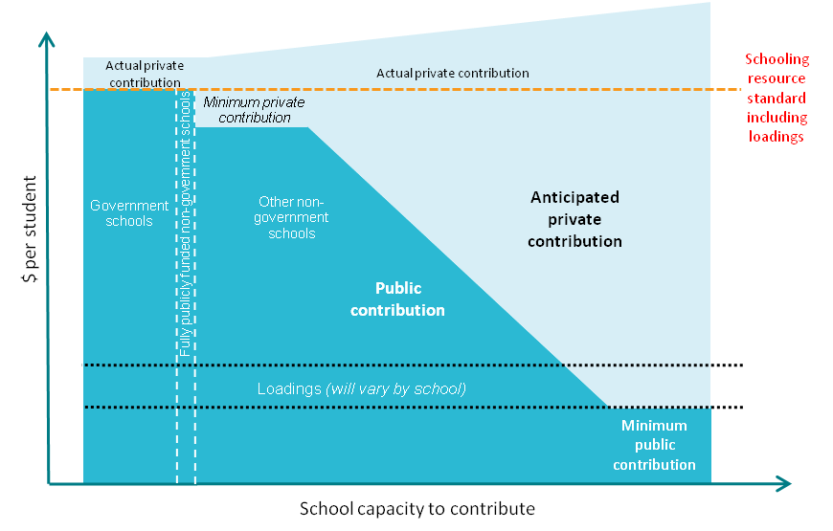
Proposed model for funding the SRS

Slide 31
SRS loadings – indicative ranges
 | From (lower end of range) | to (upper end of range)
School size and location | 10% for medium-sized schools in remote locations | 100% for very small schools in very remote locations
Low socioeconomic status | 10% for each low SES student in schools with under 10% of students in the lowest SES quarter | 50% for each low SES student in schools with more than 75% of students in the lowest SES quarter
Indigeneity | 40% for each Indigenous student in schools with between 5% and 25% of students who are Indigenous | 100% for each Indigenous student in schools with more than 75% of students who are Indigenous
Limited English language proficiency | 15% for each student with limited English proficiency | 25% for each student with limited English proficiency (for example, recently arrived refugees)
Note: The loadings for SWD to be determined after nationally consistent definitions and data become available

Slide 32
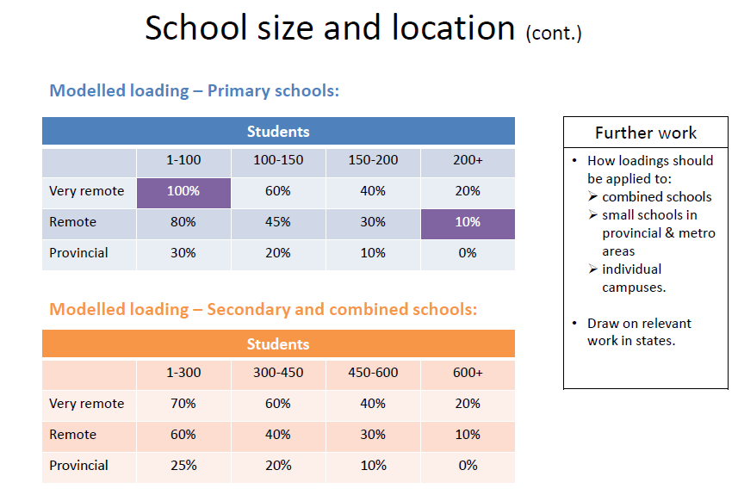

Slide 33
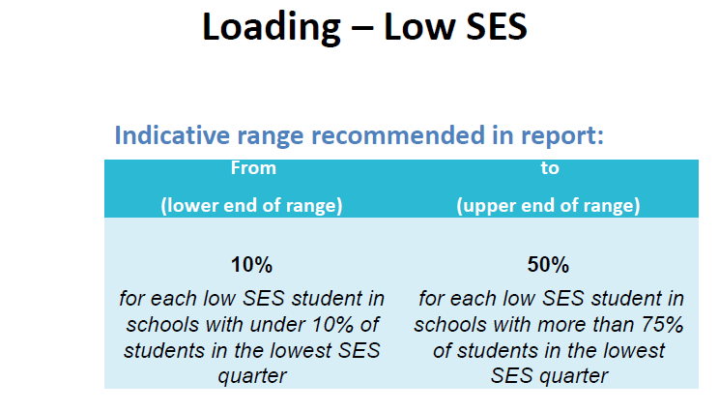

Slide 34
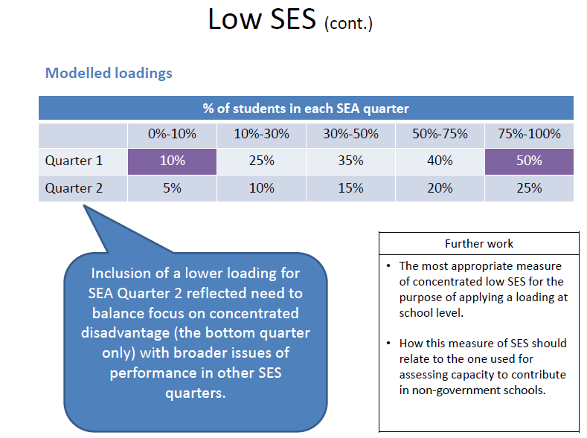

Slide 35
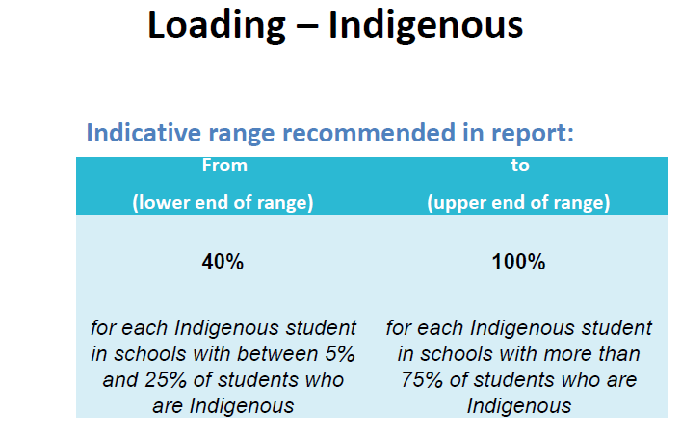

Slide 36
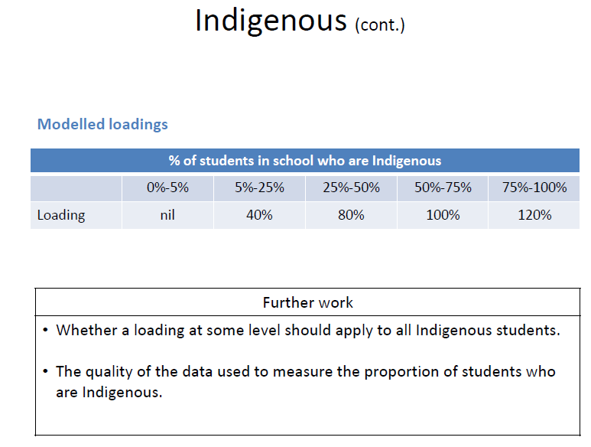

Slide 37
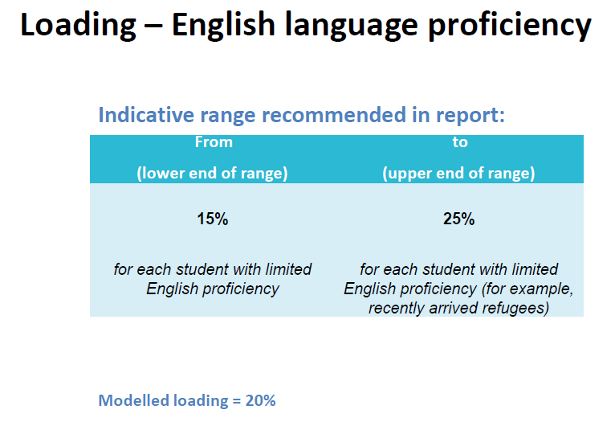

Slide 38
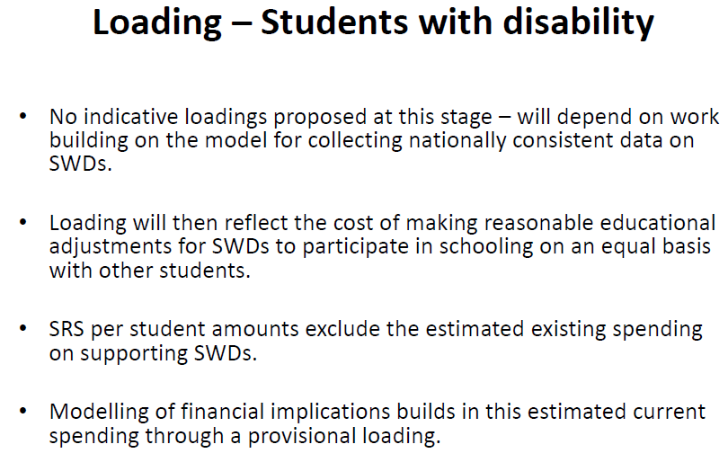

Slide 39
Composition of reference group schools

Slide 40
Impact of SRS – independent sector
2010 Data
 | NSW | VIC | QLD | SA | WA | TAS | NT | ACT | AUST | Diff 2009-2010
Winners
No. | 262 | 195 | 155 | 88 | 98 | 28 | 16 | 3 | 845 | -34
$ million | $125.6 | $154.7 | $122.4 | $54.8 | $39.6 | $11.3 | $13.6 | $0.6 | $522.5 | -$78.3
Losers
No. | 103 | 14 | 20 | 9 | 46 | 0 | 5 | 13 | 210 | 35
$ million | -$70.7 | -$5.1 | -$9.9 | -$2.2 | -$22.6 | $0.0 | -$2.7 | -$22.9 | -$136.2 | -$4.8

Slide 41
Impact of SRS - SRS Model and ‘Transition’
2010 Data
 | NSW | VIC | QLD | SA | WA | TAS | NT | ACT | AUST | Diff 2009-2010
FM to SRS model | 20 | 18 | 12 | 11 | 3 | 1 | 8 | 0 | 73 | -10
SES to SRS model | 242 | 177 | 143 | 77 | 95 | 27 | 8 | 3 | 772 | -24
FM to transition | 61 | 7 | 10 | 6 | 11 | 0 | 4 | 12 | 111 | 11
SES to transition | 42 | 7 | 10 | 3 | 35 | 0 | 1 | 1 | 99 | 24

Slide 42
News Ltd – modelling summary
Losers under Gonski
 | NSW | VIC | QLD | SA | WA | TAS | NT | ACT | Australia
Government | 720 | 298 | 355 | 203 | 541 | 77 | 63 | 73 | 2,330
Catholic | 227 | 212 | 104 | 37 | 101 | 4 | 3 | 26 | 714
Independent | 103 | 14 | 20 | 9 | 46 | 0 | 5 | 13 | 210
All sectors | 1,050 | 524 | 479 | 249 | 688 | 81 | 71 | 112 | 3,254
Losers as % of all schools
 | NSW | VIC | QLD | SA | WA | TAS | NT | ACT | Australia
Government | 33% | 20% | 29% | 38% | 72% | 43% | 42% | 89% | 35%
Catholic | 42% | 44% | 36% | 38% | 64% | 11% | 20% | 96% | 44%
Independent | 28% | 7% | 11% | 9% | 32% | 0% | 24% | 81% | 20%
All sectors | 34% | 24% | 28% | 34% | 65% | 33% | 38% | 90% | 35%

Slide 43
News Ltd – modelling implications
 | Current $ | Gonski $ | Overall $ Change | Gain | Lose
ACT C | $93,163,123 | $69,753,950 | -$23,409,173 | 1 | 26
ACT G | $427,348,592 | $371,160,564 | -$56,188,029 | 9 | 73
ACT I | $79,863,821 | $57,477,766 | -$22,386,055 | 3 | 13
NSW C | $1,730,261,046 | $1,772,817,759 | $42,556,713 | 308 | 227
NSW G | $7,932,700,622 | $8,884,687,847 | $951,987,225 | 1,485 | 720
NSW I | $1,204,286,833 | $1,259,167,846 | $54,881,013 | 262 | 103
NT C | $58,165,264 | $73,324,144 | $15,158,880 | 12 | 3
NT G | $509,099,112 | $539,473,120 | $30,374,007 | 87 | 63
NT I | $61,975,845 | $72,812,668 | $10,836,823 | 16 | 5
Qld C | $1,078,209,073 | $1,102,930,335 | $24,721,262 | 185 | 104
Qld G | $5,057,245,869 | $5,839,300,260 | $782,054,391 | 875 | 355
Qld I | $745,332,916 | $857,877,916 | $112,545,000 | 155 | 20
SA C | $363,587,401 | $381,452,761 | $17,865,360 | 61 | 37
SA G | $1,808,441,606 | $1,948,575,217 | $140,133,611 | 338 | 203
SA I | $329,959,679 | $382,594,349 | $52,634,670 | 88 | 9
Tas C | $118,659,770 | $134,588,578 | $15,928,808 | 32 | 4
Tas G | $618,055,280 | $669,407,758 | $51,352,477 | 104 | 77
Tas I | $73,114,877 | $84,370,400 | $11,255,523 | 28 | 0
Vic C | $1,487,514,575 | $1,612,747,299 | $125,232,724 | 269 | 212
Vic G | $5,224,797,046 | $6,316,184,469 | $1,091,387,424 | 1,217 | 298
Vic I | $711,464,028 | $861,584,981 | $150,120,953 | 199 | 14
WA C | $585,996,549 | $547,819,954 | -$38,176,595 | 57 | 101
WA G | $3,151,610,906 | $2,900,714,972 | -$250,895,934 | 215 | 541
WA I | $480,141,926 | $497,106,463 | $16,964,538 | 98 | 46
Total | $33,930,995,760 | $37,237,931,375 | $3,306,935,615 | 6,104 | 3,254

Slide 44
Independent sector key messages
Summary
No loss of funding in real terms | 
2. Direct relationship between Commonwealth and the non-government sector | 
3. Legislated funding quadrennium or longer | 
4. Accurate measure of the cost of educating a child in a government school | ?
5. Annual indexation |  ?
6. Increased and continuing capital and targeted funding | 
7. Projected enrolment growth and partnership with governments | ?
8. Funding must be based on robust data | 
9. Consistent application of funding model | ?

Slide 45
National Plan for School Improvement
A new way of funding schools
More help for students who need it most
Helping schools improve results
Helping great teachers do a great job
More information about schools
Phased in over 6 years

Slide 46
Funding Legislation Timeline
Jan 2007 |  |  |  |  |  |  |  | Federal Election | Dec 2007
Jan 2008 | Legislation for new funding quadrennium passed |  |  |  |  |  |  |  | Dec 2008
Jan 2009 |  |  |  |  |  |  |  |  | Dec 2009
Jan 2010 |  |  | Review of schools funding |  |  |  |  |  | Dec 2010
 |  |  |  | Federal Election
Jan 2011 | Review of schools funding |  |  |  |  |  |  |  | Dec 2011
 | Amend Schools Assistance Act for 2013
Jan 2012 | Release Gonski Report |  | PM accepts report/ negotiations commence |  |  | Australian Education Bill introduced - National Plan for School Improvement |  |  | Dec 2012
Jan 2013 | Negotiations |  | Amend Legislation for new funding |  |  |  |  |  | Dec 2013
 |  |  |  |  | Federal Election
Jan 2014 | Transition commences |  |  |  |  |  |  |  | Dec 2014
Jan 2015 |  |  |  |  |  |  |  |  | Dec 2015
Jan 2016 |  |  |  |  |  |  |  | Federal Election | Dec 2016
Jan 2017 |  |  |  |  |  |  |  |  | Dec 2017
Jan 2018 |  |  |  |  |  |  |  |  | Dec 2018
Jan 2019 |  |  |  |  |  |  |  | Federal Election | Dec 2019
Jan 2020 | Transition completed |  |  |  |  |  |  |  | Dec 2020

